Slide 1
Dementia in People with Down syndrome - Resources
These resources relate to the presentation on Down syndrome and dementia given by Julian Trollor and Liz Evans.
Notes:
Yet to compile.
Not going through all the resources in the session – just mention that we have compiled them and they will be on our website/shared with them via a handout?

Slide 2
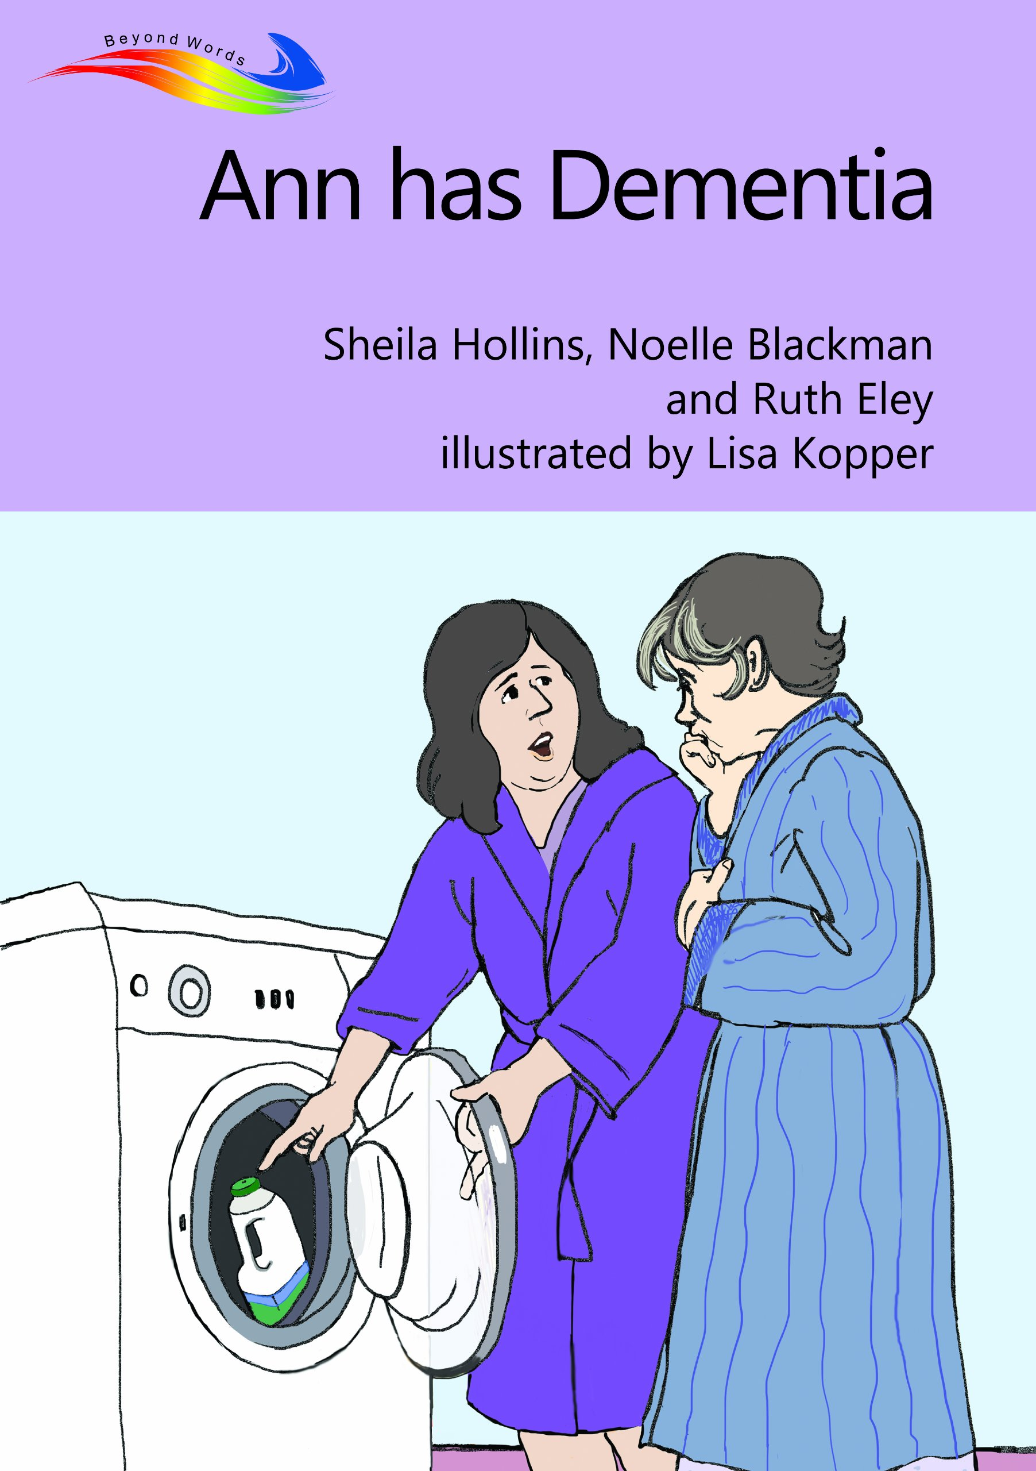
For people with intellectual disability:
Easy read factsheet from Alzheimer’s Society (UK):
https://www.alzheimers.org.uk/site/scripts/download_info.php?downloadID=1092
Jenny’s diary is a book made of a set of postcards, designed to facilitate conversations with people with ID about dementia. There is a section for talking with people who are friends with the person, as well as a section for talking with the person who has dementia.
https://www.stir.ac.uk/about/faculties-and-services/health-sciences-sport/research/research-groups/enhancing-self-care/jennys-diary/
About my friend by Karen Dodd, Vicky Turk and Michelle Christmas (2005). A resource to assist friends of people Down's syndrome and dementia.
Ann has dementia. By Sheila Hollins, Noelle Blackman and Ruth Eley. Illustrated by Lisa Kopper. A story told in pictures, available from Books beyond words. https://booksbeyondwords.co.uk/ebooks/ann-has-dementia?rq=dementia

Slide 3
For families and carers - Books
  Intellectual disabilities and dementia: a guide for families edited by Karen Watchman (2017)
  Jenny’s diary is made of postcards, designed to facilitate conversations with people with ID about dementia in particular. There is a section for talking with people who are friends with the person, as well as a section for talking with the person who has dementia. Available here:
https://www.stir.ac.uk/about/faculties-and-services/health-sciences-sport/research/research-groups/enhancing-self-care/jennys-diary/
Dementia Australia library service:
Books loaned by post 4 or 8 weeks
Their list on dementia and Down syndrome is here: https://www.dementia.org.au/files/library/Down%20Syndrome%20and%20dementia.pdf

Slide 4
For families and carers – websites:
The carer checklist recommended by the US National Task Group: http://aadmd.org/ntg/screening
Websites with information and resources:
  Karen Watchman’s website :www.learningdisabilityanddementia.org
  The Down’s Syndrome (UK) website http://dsagsl.org/wp-content/uploads/2012/11/ds_and_alzheimers1.pdf
  The BILD (UK) website http://www.bild.org.uk/resources/ageingwell/dementia/
  Down syndrome Australia: https://www.downsyndrome.org.au/documents/resources/health/Down_syndrome_and_Alzheimers_disease.pdf
Dementia Australia has made a video about dementia in people with intellectual disability, available through the “resource finder” section of their website.
Living with Dementia booklet from Down syndrome Scotland. Includes practical environmental modifications. https://www.dsscotland.org.uk/resources/publications/for-parents-of-adults/

Slide 5
For health & disability professionals
The carer checklist recommended by the US National Task Group is available from this site: http://aadmd.org/ntg/screening. Other resources and webinars: http://aadmd.org/ntg
3DN resources @ https://3dn.unsw.edu.au/content/health-mental-health-professionals :
  Dementia in people with Intellectual Disability: Guidelines for Australian GPs; Cardiometabolic Resources
  E-learning modules for health & disability professionals: www.idhealtheducation.edu.au
Webinars & resources from US National Task Group: http://aadmd.org/ntg
This is an Australian resource to facilitate conversations about end of life care for people with intellectual disability. https://www.caresearch.com.au/TEL/
Jokinen, N., Janicki, M. P., Keller, S. M., McCallion, P., & Force, L. T. (2013). Guidelines for structuring community care and supports for people with intellectual disabilities affected by dementia. Journal of policy and practice in intellectual disabilities, 10(1), 1-24.
Book: Down's syndrome and dementia: a resource for carers and support staff/ Dodd, Karen (2009) Website: ‘Supporting Derek’ (UK). Includes video and booklet resource for people working with people with intellectual disability and dementia. https://www.jrf.org.uk/report/supporting-derek-new-resource-staff-working-people-who-have-learning-difficulty-and-dementia
Notes:
Add also – Michelle Weise’s stuff

